Slide 1

Managing for Results Strategic Planning Training for State Agencies March 7, 2016

Slide 2
Why Strategic Planning?
There’s an old saying: “If you don’t know where you’re going, any road will get you there.”
What is the agency’s vision about where it needs to go?
Where is the agency now?
How will the agency get to the desired destination?
How will the agency measure its progress?

Slide 3
What are Strategies?
Action Plans
Tasks with timeframes.
Tasks that will help to achieve specific objectives.
Procedures and processes.
Each strategy should have a list of processes, persons responsible for each process, time table, and list of resources needed.

Slide 4
Examples of Strategies
Update the regional inventory of highways by December 2016.
Identify high cost users of prescriptions in the Medicaid program and do an in-depth audit.
Identify barriers to processing applications in specific DSS offices with timeliness issues.
Train 50% of staff on new software by July 2017.
For FY 2017, refine the forms used by staff to record complaints.

Slide 5

What Do You Want To Get From This Training?
Split into small groups, assign a note-taker, and share:
What do you hope to learn or better understand from this training session?
What are the biggest challenges you face with strategic planning in your agency?

Slide 6

New Performance Reporting Procedure
Governor’s Office of Performance Improvement
No more StateStat templates – though some select StateStat data may move to the MFR submission template
Dashboard measures: monthly, quarterly or annually
Uploaded to the Open Data Portal
Additional components, due August 19
SWOT Analysis
Customer Assessment

Slide 7
New Performance Reporting Procedure
Department of Budget and Management
Managing For Results (MFR) measures: submitted annually in Excel format (provided by DBM in early summer), due August 19.
If the MFR submission process moves to the Open Data Portal, agencies will be notified no later than mid-May.
Other submission components due August 19:
Performance Discussion
Data Definitions and Controls
Certification Statement

Slide 8
Detail on Submission Requirements
SWOT Analysis (Office of Performance Improvement)
S
W
SWOT
Internal Factors
Strengths
Weaknesses
O
T
External Factors
Opportunities
Threats
Positive
Negative

Slide 9
Detail on Submission Requirements
SWOT Analysis (Office of Performance Improvement)

Slide 10

Detail on Submission Requirements
Customer Assessment (Office of Performance Improvement)
Why customer service?
External customers: The people of Maryland
Internal customers: Agency and department staff
Customer service standards
Feedback and transparency

Slide 11
Detail on Submission Requirements
Performance Discussion (Managing for Results)
No specific format: the agency may discuss overall performance or focus on specific programs or initiatives.
Describe what performance data reveal about agency performance.
Agencies may submit documents that are produced for other purposes that discuss performance related to MFR measures; for example, reports to the legislative committees, reports to the Federal government, and annual reports.

Slide 12
Performance Discussion (continued)
A typical performance discussion document includes:
A concise statement of overall performance including what reported outcome and efficiency measures and other indicators show about the effectiveness and efficiency of the agency;
Outcomes attained and explanations for performance that surpasses, meets, or fails to achieve targets;
As applicable, a comparison of performance to similar programs in other jurisdictions using information from national standards, published articles, benchmarking, experience of similar states, etc.

Slide 13
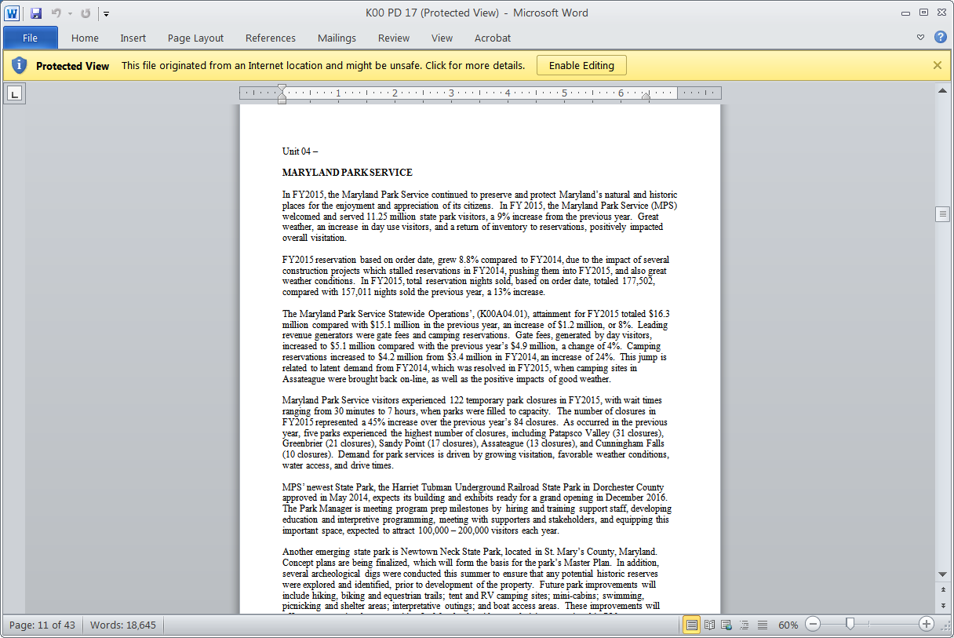
Detail on Submission Requirements
Performance Discussion (Managing for Results)
DBM is happy to provide examples by request.

Slide 14
Detail on Submission Requirements
Data Definitions and Controls (Managing for Results)
Data definitions and control procedures are the first step toward ensuring data integrity.
Submit data definitions and control procedures for agency-level measures for which documentation has not been previously submitted or where updates are necessary for FY 2018.

Slide 15
Detail on Submission Requirements
Data Definitions and Controls (Managing for Results)
Data definitions should:
Include detailed description of how the measure is calculated to allow for replication;
Describe the primary source(s) of information, its method of collection and storage;
Identify whether data is cumulative or non-cumulative;
Identify any data limitations, including factors beyond the agency's control.

Slide 16
Detail on Submission Requirements
Data Definitions and Controls (Managing for Results)
Three Types of Data Controls:
Input controls provide reasonable assurance that data collection is accurate. Examples:
data-entry training
written and established guidelines and procedures for data entry that are used consistently
supervisory review for accuracy of information entered into the computer system
documentation of the control structure from providers of third-party data

Slide 17
Data Definitions and Controls (Continued)
Process controls provide reasonable assurance that performance measurement systems use the appropriate information and follow procedures established for data gathering and calculation of each measure.
Examples:
review of computer programs used to calculate or store performance data to ensure the correct information is being captured and the desired functions are being performed
personnel understand the origin of the information and stay current with any changes in its form
written procedures exist for collecting and calculating measures

Slide 18
Data Definitions and Controls (Continued)
Review controls are procedures to verify that an activity occurred and was correctly calculated to provide reasonable assurance that accurate data is reported.
Examples:
communication with executive management to ensure that the desired information is being measured or is capable of being measured
review of calculation of performance data to ensure that the calculation is consistent with the measure definition and to check for mathematical errors
internal audits of performance measures are conducted
MFR submissions are reviewed for accuracy and typographical errors

Slide 19
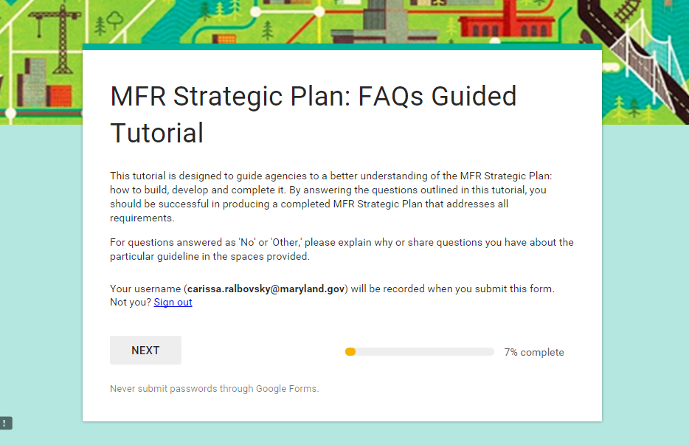
Managing for Results Tutorial
https://docs.google.com/a/maryland.gov/forms/d/1qACvRTEItyAmWvLrJcNVwcLcJzn703BZUfXsLSx6TTg/viewform?pli=1

Slide 20
Managing for Results Strategic Plan
Vision Statement
A brief and compelling description of the preferred, ideal future.
Checklist
Does the vision statement provide a clear picture of the organization’s ideal future?
Is the vision statement inspiring and challenging?
Is the vision statement brief enough to be remembered?
Will achievement of the mission help make the vision a reality?

Slide 21
Managing for Results Strategic Plan
Which vision statement is best and why?
To achieve the respect of client agencies by performing the mission in professionally and efficiently.
To be a major catalyst in the growth of international trade, to be dominant in terms of cargo flowing through East Coast ports.
A State in which the public has confidence that property assessments uniformly reflect current market values.
To be a respected and trusted leader providing public services.
We envision a future in which all Marylanders are protected from infectious diseases, environmental hazards, and hereditary disorders.

Slide 22
Managing for Results Strategic Plan
Mission Statement
A short, comprehensive statement of the reason for an organization’s existence. It succinctly identifies what an organization does (or should do), and for whom.

Slide 23
Managing for Results Strategic Plan
Mission Statement
Checklist
Does it clearly state what business you are in?
Is it sufficiently broad so everyone in the organization can see how they contribute?
Is the mission rarely changing?
Can the mission survive changes in administration?
Will it make sense to the average citizen if they see it on your office wall?
Does it answer the questions, “what do we do (or should do), and for whom?”
Is it obvious why we spend public dollars on this effort?

Slide 24
Managing for Results Strategic Plan
Which of the mission statements are well-written? Why?
To efficiently operate a public health system.
To improve health status of Marylanders through prevention, early intervention, surveillance, treatment.
To provide professional and technical services to keep State government working today and in the future.
To protect Marylanders from the illegal conduct of insurers by actively and fairly enforcing the insurance laws of Maryland.
To improve and maintain the quality of the State’s water resources to a level that supports a balanced population of aquatic resources, protects public health, and sustains a strong statewide economy.

Slide 25
Managing for Results Strategic Plan
Goals
The general end toward which an organization directs its efforts. Goals clarify the mission and vision, and provide direction, but do not state how to get there.
They are broad statements that describe desired outcomes that cannot be achieved in less than three years.
They are also general, not quantified, and do not express a specific target for achievement.

Slide 26
Goals (Continued)
Checklist
Does each goal support the mission?
Is each goal consistent with your legislative authority?
Does each goal deal with just one issue?
Does each goal represent a desired result that can be measured?
Does the goal reflect a primary activity or strategic direction?
Is the goal challenging, but still realistic and achievable?
Does the goal encompass at least three years?
Is the goal important to stakeholders?
Will someone unfamiliar with the program understand what the goal means?

Slide 27
Goals (Continued)
Which goal is best and why?
Effective resource management.
To provide reliable and accurate information technology systems for use by State agencies.
Administer Federal grant programs.
To provide emergency services to Marylanders as quickly and efficiently as possible.
Increase productivity, customer service, and interagency workings.
Reduce Maryland’s consumption of petroleum fuels through increased use of alternative fuels and advanced transportation technologies.

Slide 28
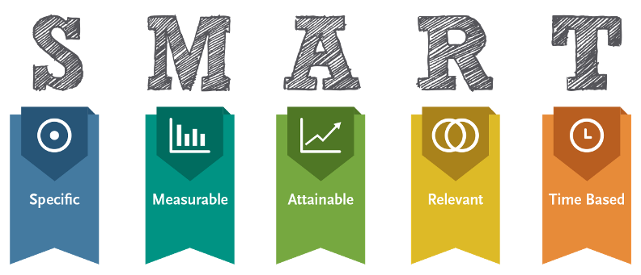
Managing for Results Strategic Plan
Objectives
Specific and measurable targets for accomplishment of a goal.
Specific
Measureable
Attainable
Relevant
Time Based
S
M
A
R
T

Slide 29
Objectives (Continued)
Checklist
Do the objectives reflect specific accomplishments?
Can progress towards completion be measured?
Is the objective aggressive/challenging, yet realistic and attainable with available time and resources?
Is there a specific time frame for completion?
Does the time-bound component of your SMART objectives stay the same for a few years?
Have you identified who will be accountable?
Will completion of objective lead to goal attainment?
Is there at least one objective for each stated goal or set of goals?
Will someone unfamiliar with the budget unit or program understand what the objective means?

Slide 30
Objectives (Continued)
Which objective is best and why?
Reduce per capita peak electricity demand and consumption 15 percent by 2015, compared to 2007 baseline.
Reduce water consumption
Annually collect samples and contribute to the assessment of water quality status in the Chesapeake Bay and its tributaries.
By 2005, 90% of full-time circuit court attorneys will handle a caseload of between 80% and 120% of the American Bar Association maximum caseload standards.
Prepare early state biotechnology companies to be successful, leading to job creation.

Slide 31
Managing for Results Strategic Plan
Performance Metrics
A system of customer-focused, quantified indicators that tell an organization if it is meeting its goals and objectives.
INPUTS: the amount of resources used to provide a particular product or service
OUTPUTS: the amount of goods and services provided, in other words the number of activities completed
OUTCOMES: the results that will be achieved
EFFICIENCY: the relationship between unit cost or productivity, and a given outcome or output
QUALITY: how well you met the expectations of your customers

Slide 32
Managing for Results Strategic Plan
Performance Metrics
Checklist
Does your MFR strategic plan focus on outputs and outcomes instead of inputs?

Slide 33
Performance Metrics (Continued)
Label each performance metric as an input, output, outcome, efficiency or quality measure.
Number of Marylanders served by public water systems.
Percent of Marylanders served by public water systems in compliance with all drinking water regulations.
Number of children tested for elevated blood lead
Number of vehicles stolen statewide
Yearly change in vehicle thefts in jurisdictions receiving Vehicle Theft Prevention Council funding
Enrollment in public high schools
Employment rate of five-year-out alumni
Number of students receiving State financial aid

Slide 34
Thank you! What did we miss that you wanted to get out of the training session today?

